Slide 1


Team: Manikumar Perla – Aditya Gupta – Prakhar Garhwal Balder – Sai Sugeeth Kamineni Coach: Sophie Chambon
Delta

Slide 2
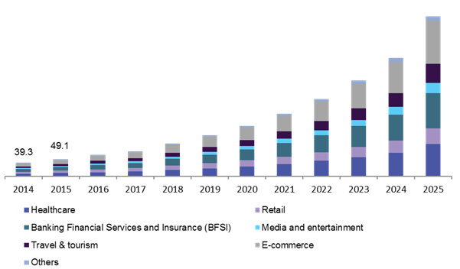
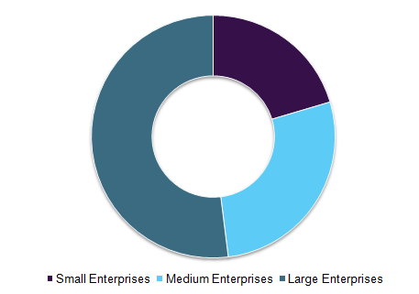
A promising future for AI powered chatbots…
The future is bright for AI powered chatbots: They will power 85% of all customer service interactions by the year 2020 – Gartner.
Chatbots market is expected to witness an exponential growth during the period 2016-2023 – Credence Research, Inc.
Images source: https://www.grandviewresearch.com/industry-analysis/chatbot-market
Notes:
By 2020,
more than 80% of companies should have implemented a means of automating conversations using bots (Business Insider, 2016)
+80% of companies will use bots to interact with their customers,
Today,
- Instant messengers today have three billion active users per month worldwide https://www.maddyness.com/2017/06/14/infographie-10-chiffres-cles-a-connaitre-marche-chatbots/
80% of the app he most downloaded are instant messaging.
The first conversational AI bot is an exciting journey for an organisation. A new channel, new engagement and lots of opportunities. However, when you’ve passed the decision-tree-chatbot phase, you face new challenges: bot proliferation. A lot of bots not integrated or collaborating but serving their unique purpose. Some built on proprietary some on open platforms but all with their distinctly unique unstandardised characteristics. https://chatbotsmagazine.com/how-to-manage-ai-conversations-at-enterprise-scale-26bf4ee26ac9
Managing them will become increasingly complex. This is where the Delta concept comes and makes perfect sense.
Interesting info/tips:
https://ecommerce.cioreview.com/news/proliferation-of-chatbots-in-ecommerce-nid-25217-cid-155.html

Slide 3



Huge benefits for companies and end-users
BUSINESS PROFITABILITY
SAVE
€0.42 - €0.59
PER INTERACTION
SAVE
€6.8 Billion
PER YEAR
SPEND
€547.1
PER BUSINESS
INDUSTRY LANDSCAPE
2015
More mobile messaging app usage
2016
Chatbot market takes off
2022
Chatbots are highly adopted

Slide 4



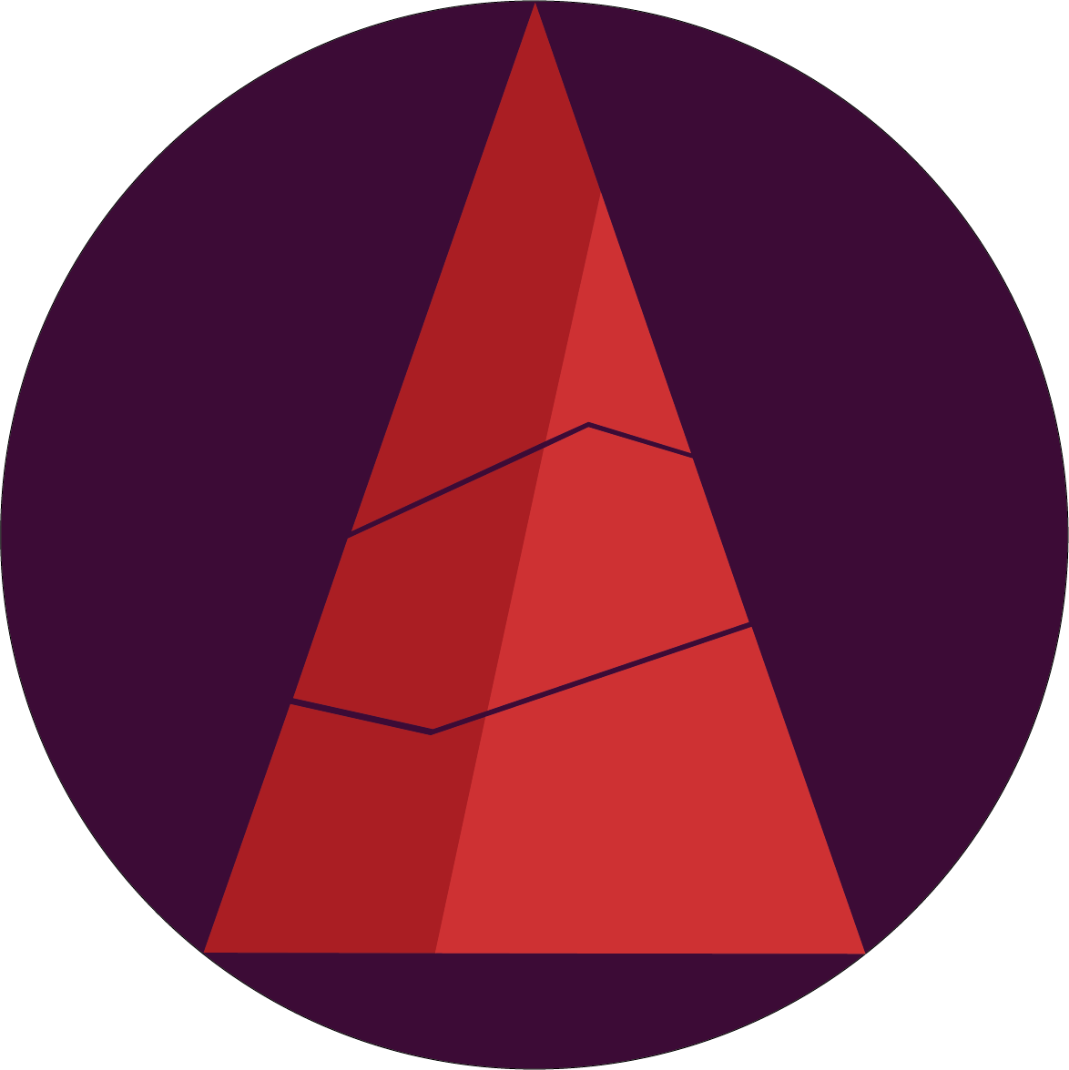

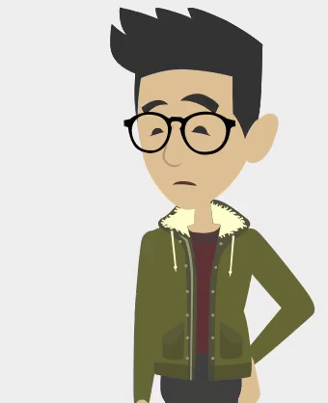
…but this will lead to an outburst of bots, creating complexity
This sudden growth will make chatbots a victim of their own success. It will be necessary to deal with this complexity.
Delta solves a lot of problems that people face with chatbots, as it provides:
Higher accessibility
Simultaneous conversations
Personalised recommendations
Less taps required
Here comes Delta! ➔

Slide 5
A single bot interface to manage your daily life.
What does this special bot offer?

Slide 6
Using Delta is simple
Ask Delta for a chatbot service
Delta brings
the chatbot
Yay! Talk to the chatbot
Order food, ask for taxi, get a ticket for cinema…
Be connected to the corresponding chatbot…
Interact with the chatbot and get your request satisfied…

Slide 7
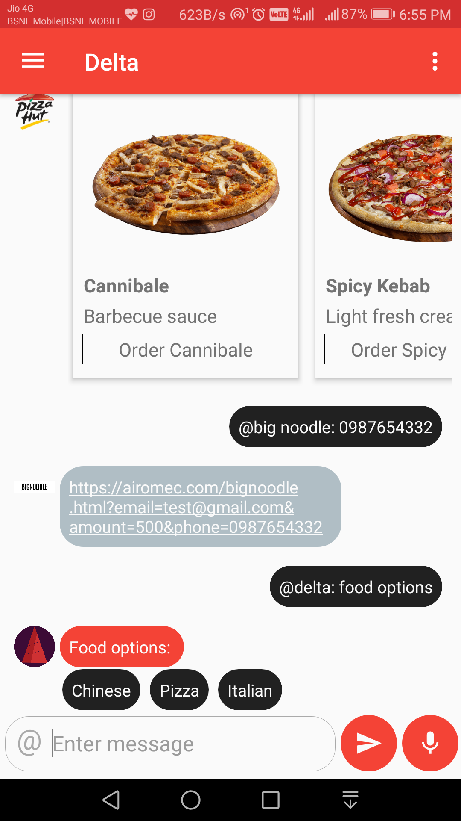
How can we forget rich messages?
Image
Cards
Buttons
Links
Text message
Quick replies / Suggestions

Slide 8
Levels of identifying needs
Desire
I’m hungry
I am bored
I wanna eat pizza
I want to watch a movie
Category
Service
Bring Pizza Hut bot
Get me Cinemas chatbot

Slide 9


Delta
AI powered chatbot

Slide 10
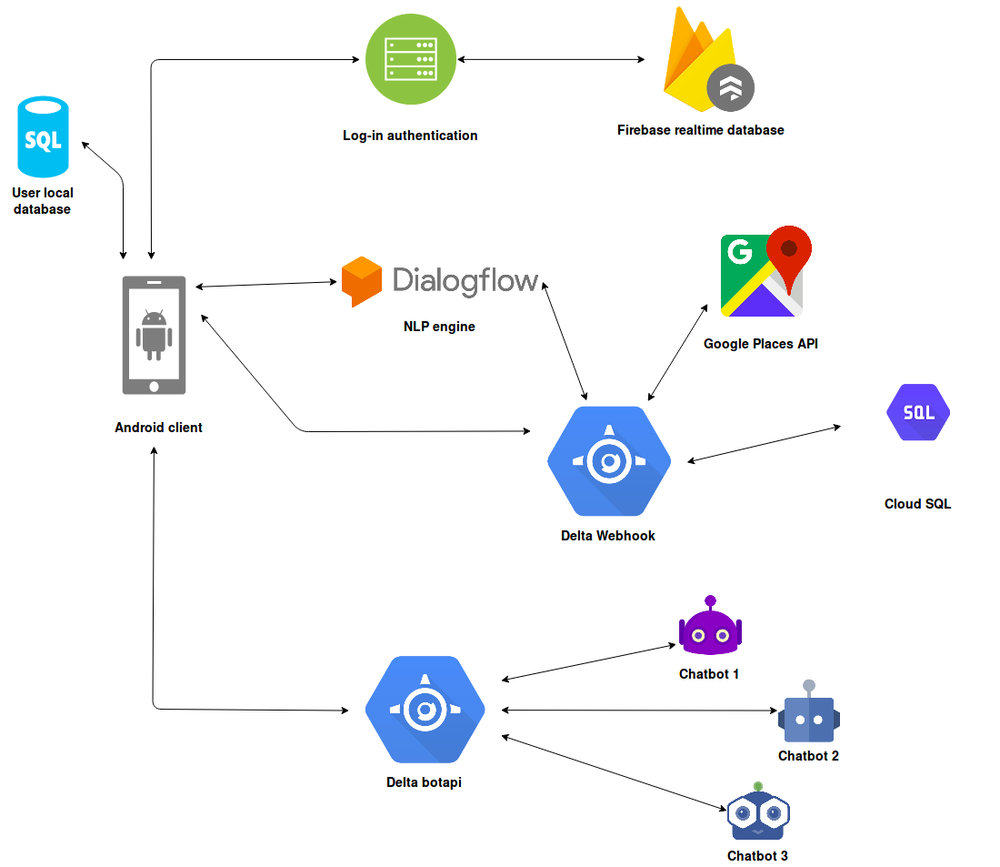
Let’s talk about the architecture

Slide 11
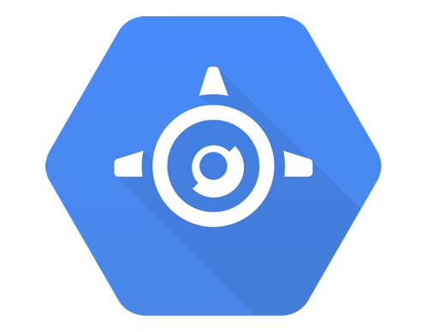


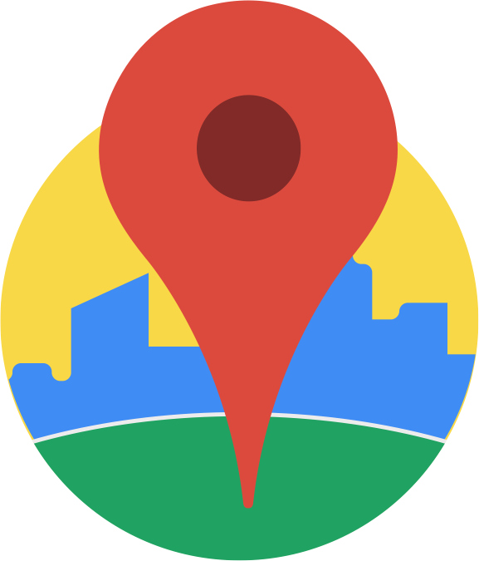
Google Cloud Platform
High availability
Scale on demand
Low priced
High performance
Fully managed
Secure
Google App engine
Google Cloud SQL
Firebase auth.
Google Places
User identification
Various authentication types
Store user’s data securely
Reliable
Authentic data
Free 1,50,000 requests/24 hours

Slide 12

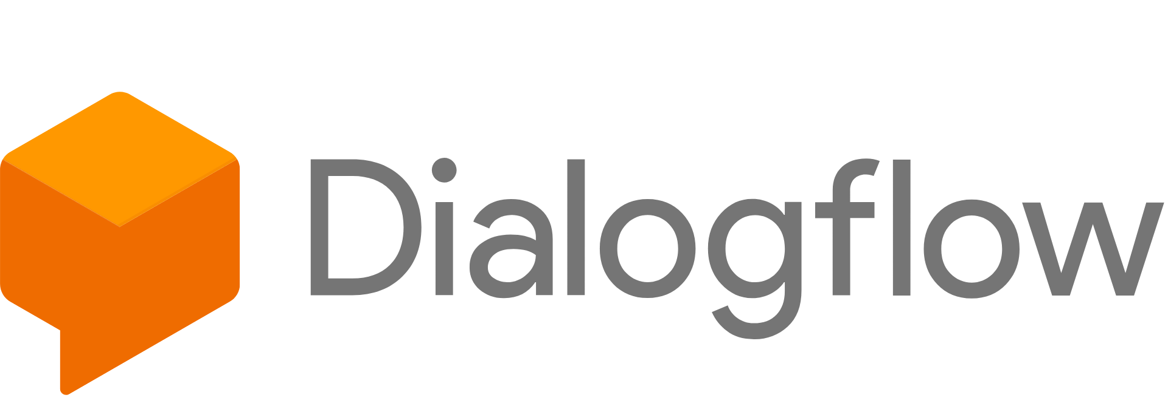
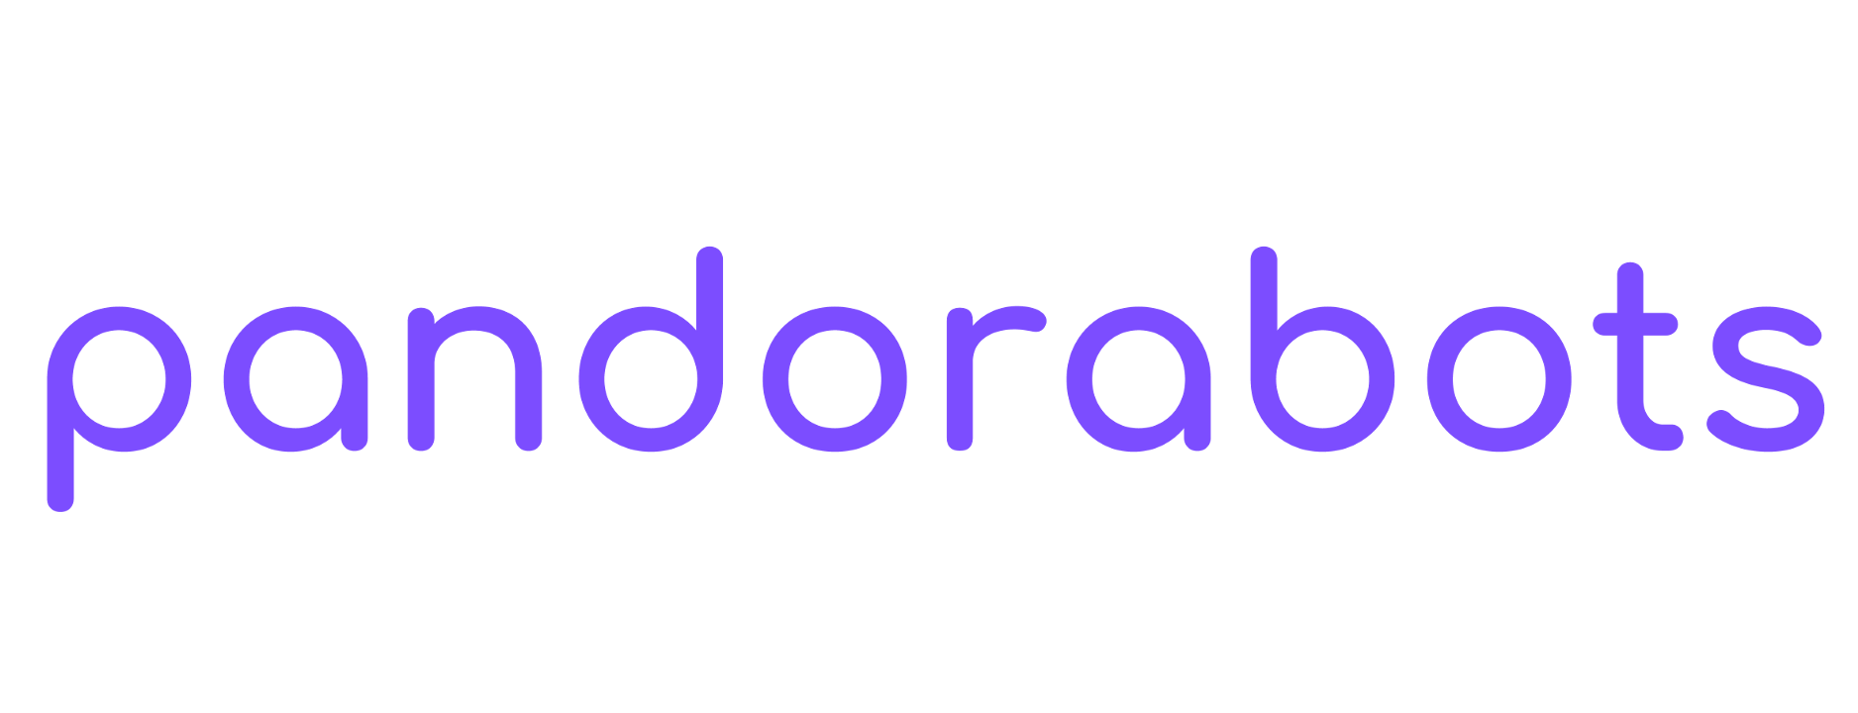
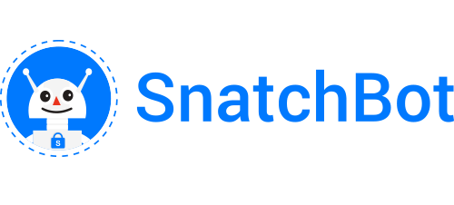

Platforms supported
And many more coming soon....

Slide 13

Let’s talk about business case
€ £ $ …

Slide 14

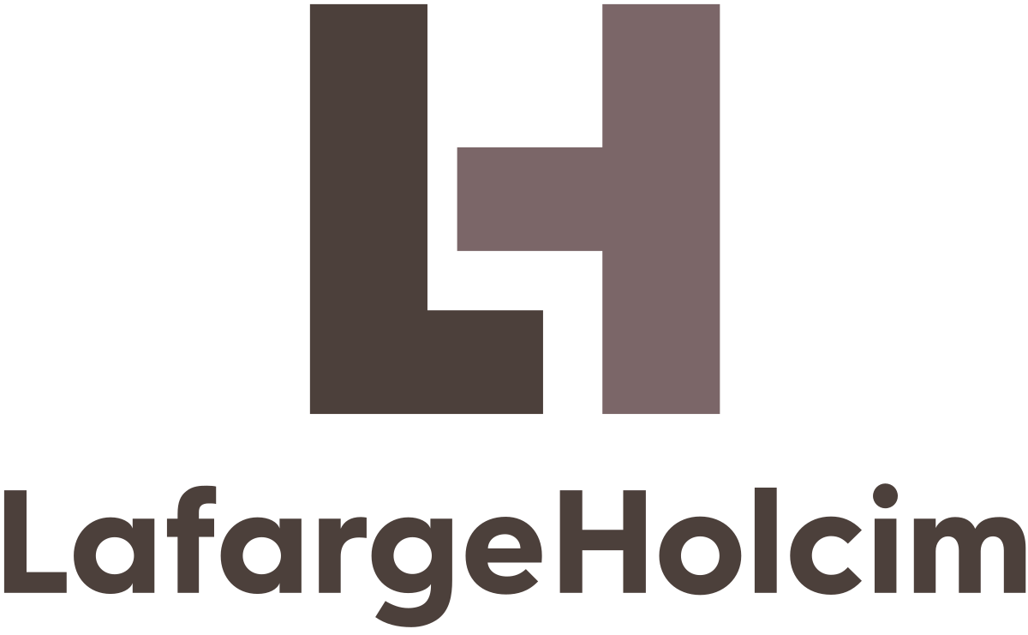
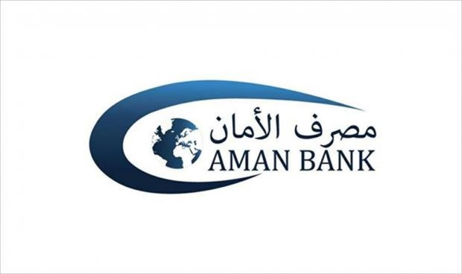


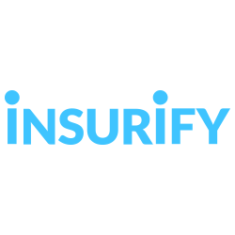
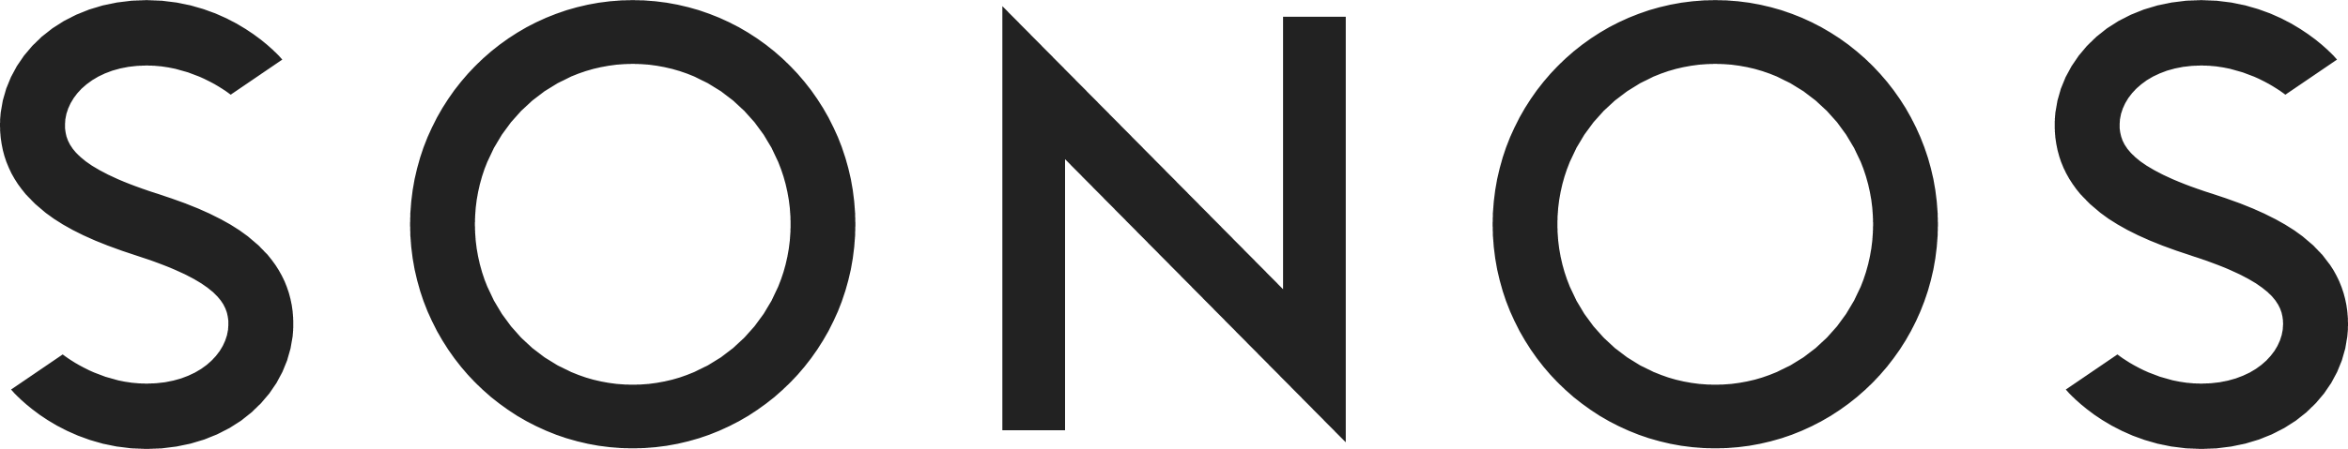
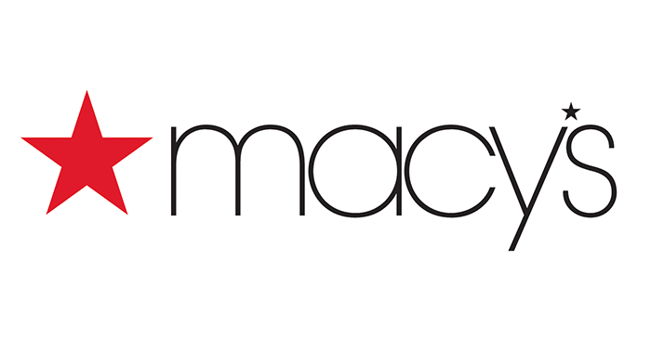
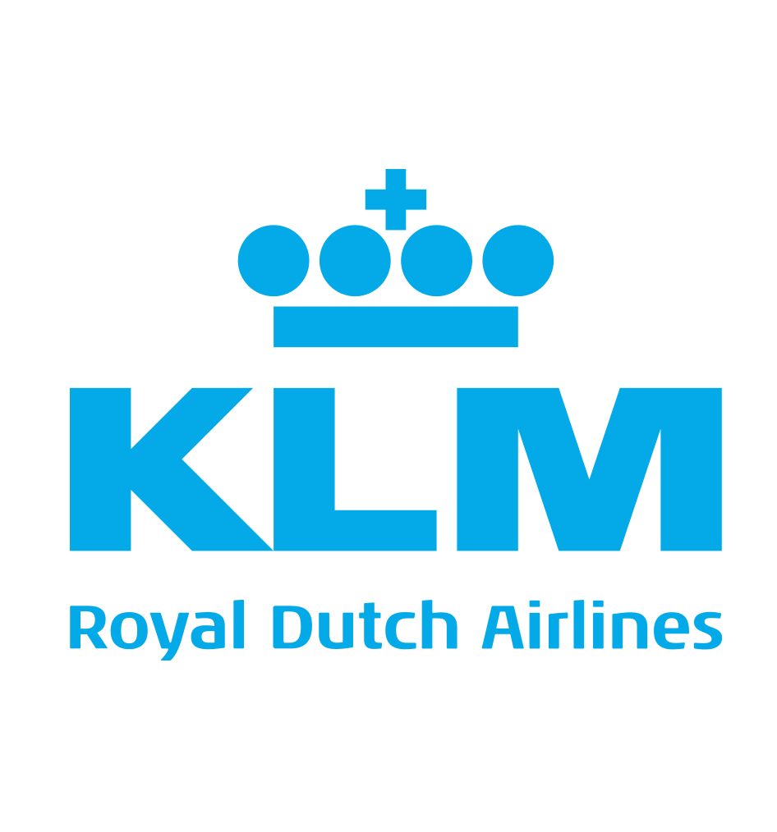
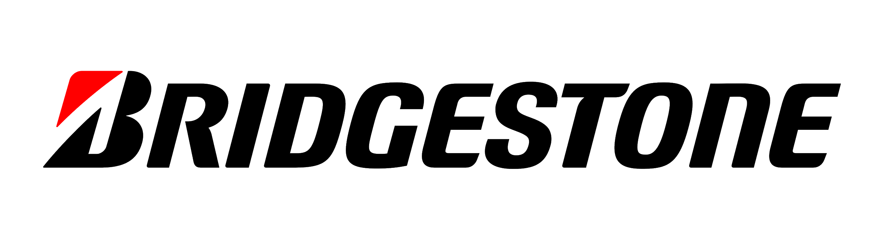

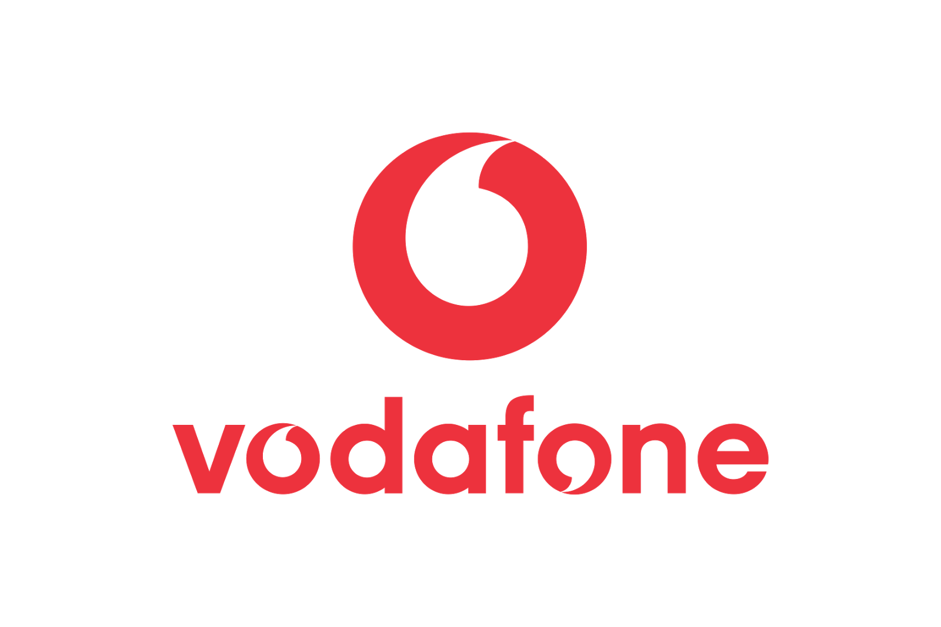

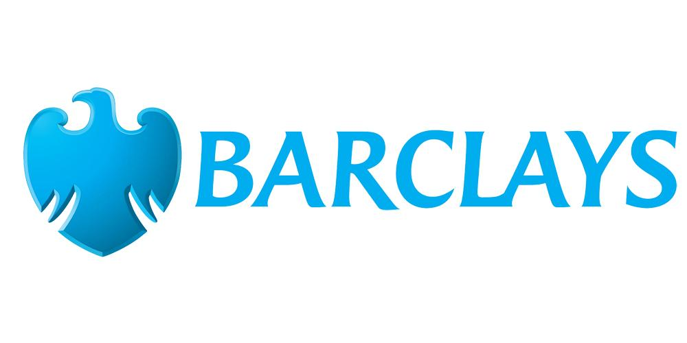

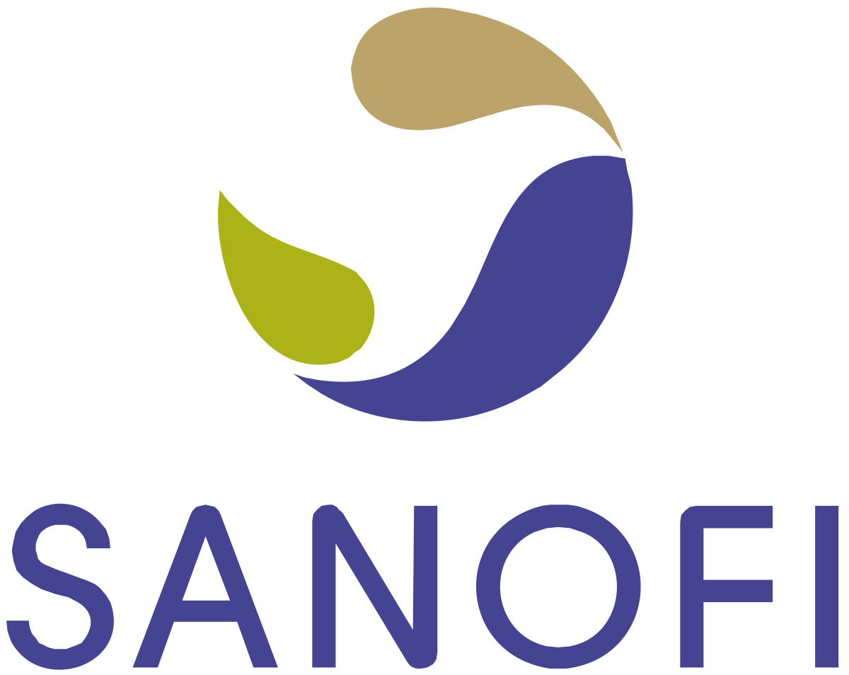
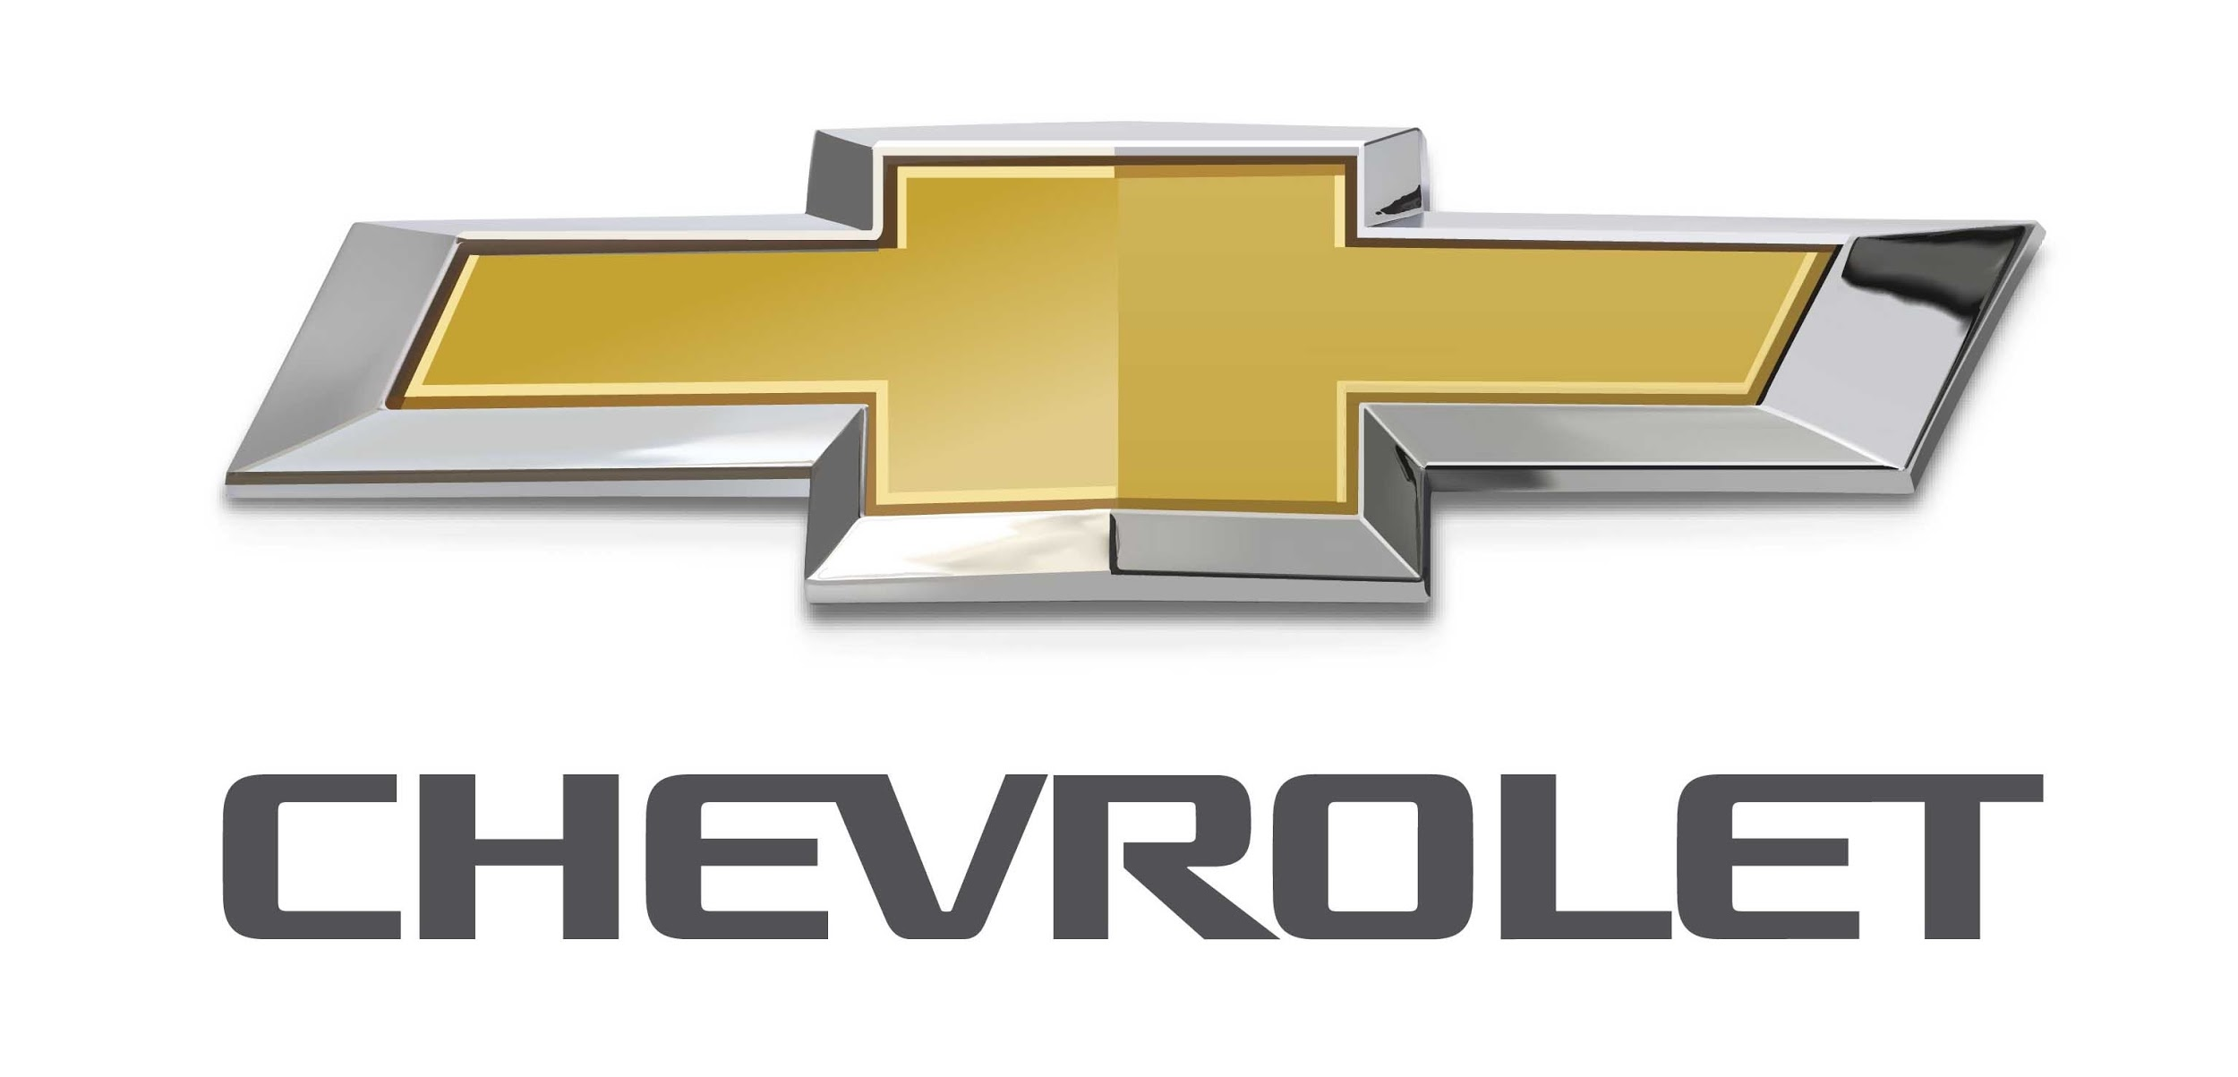
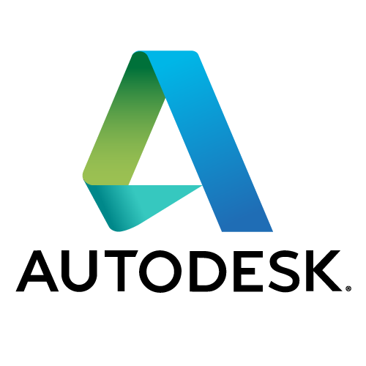
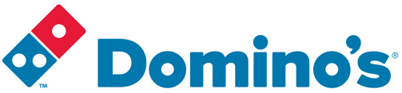
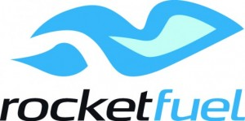
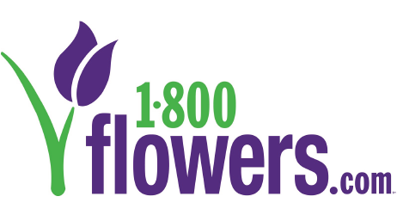
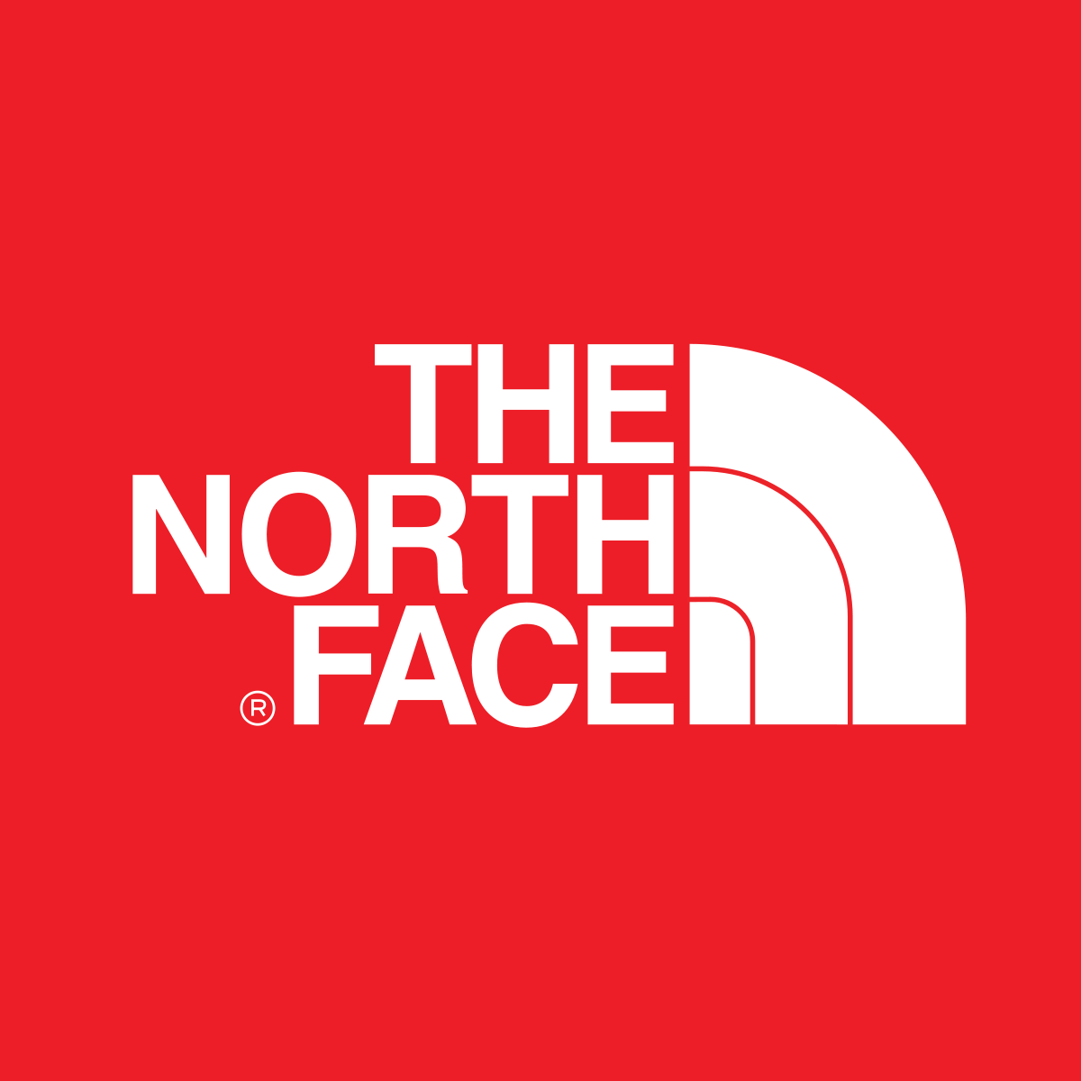

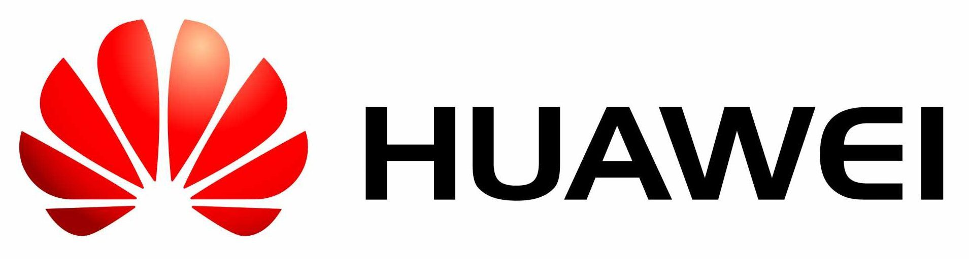


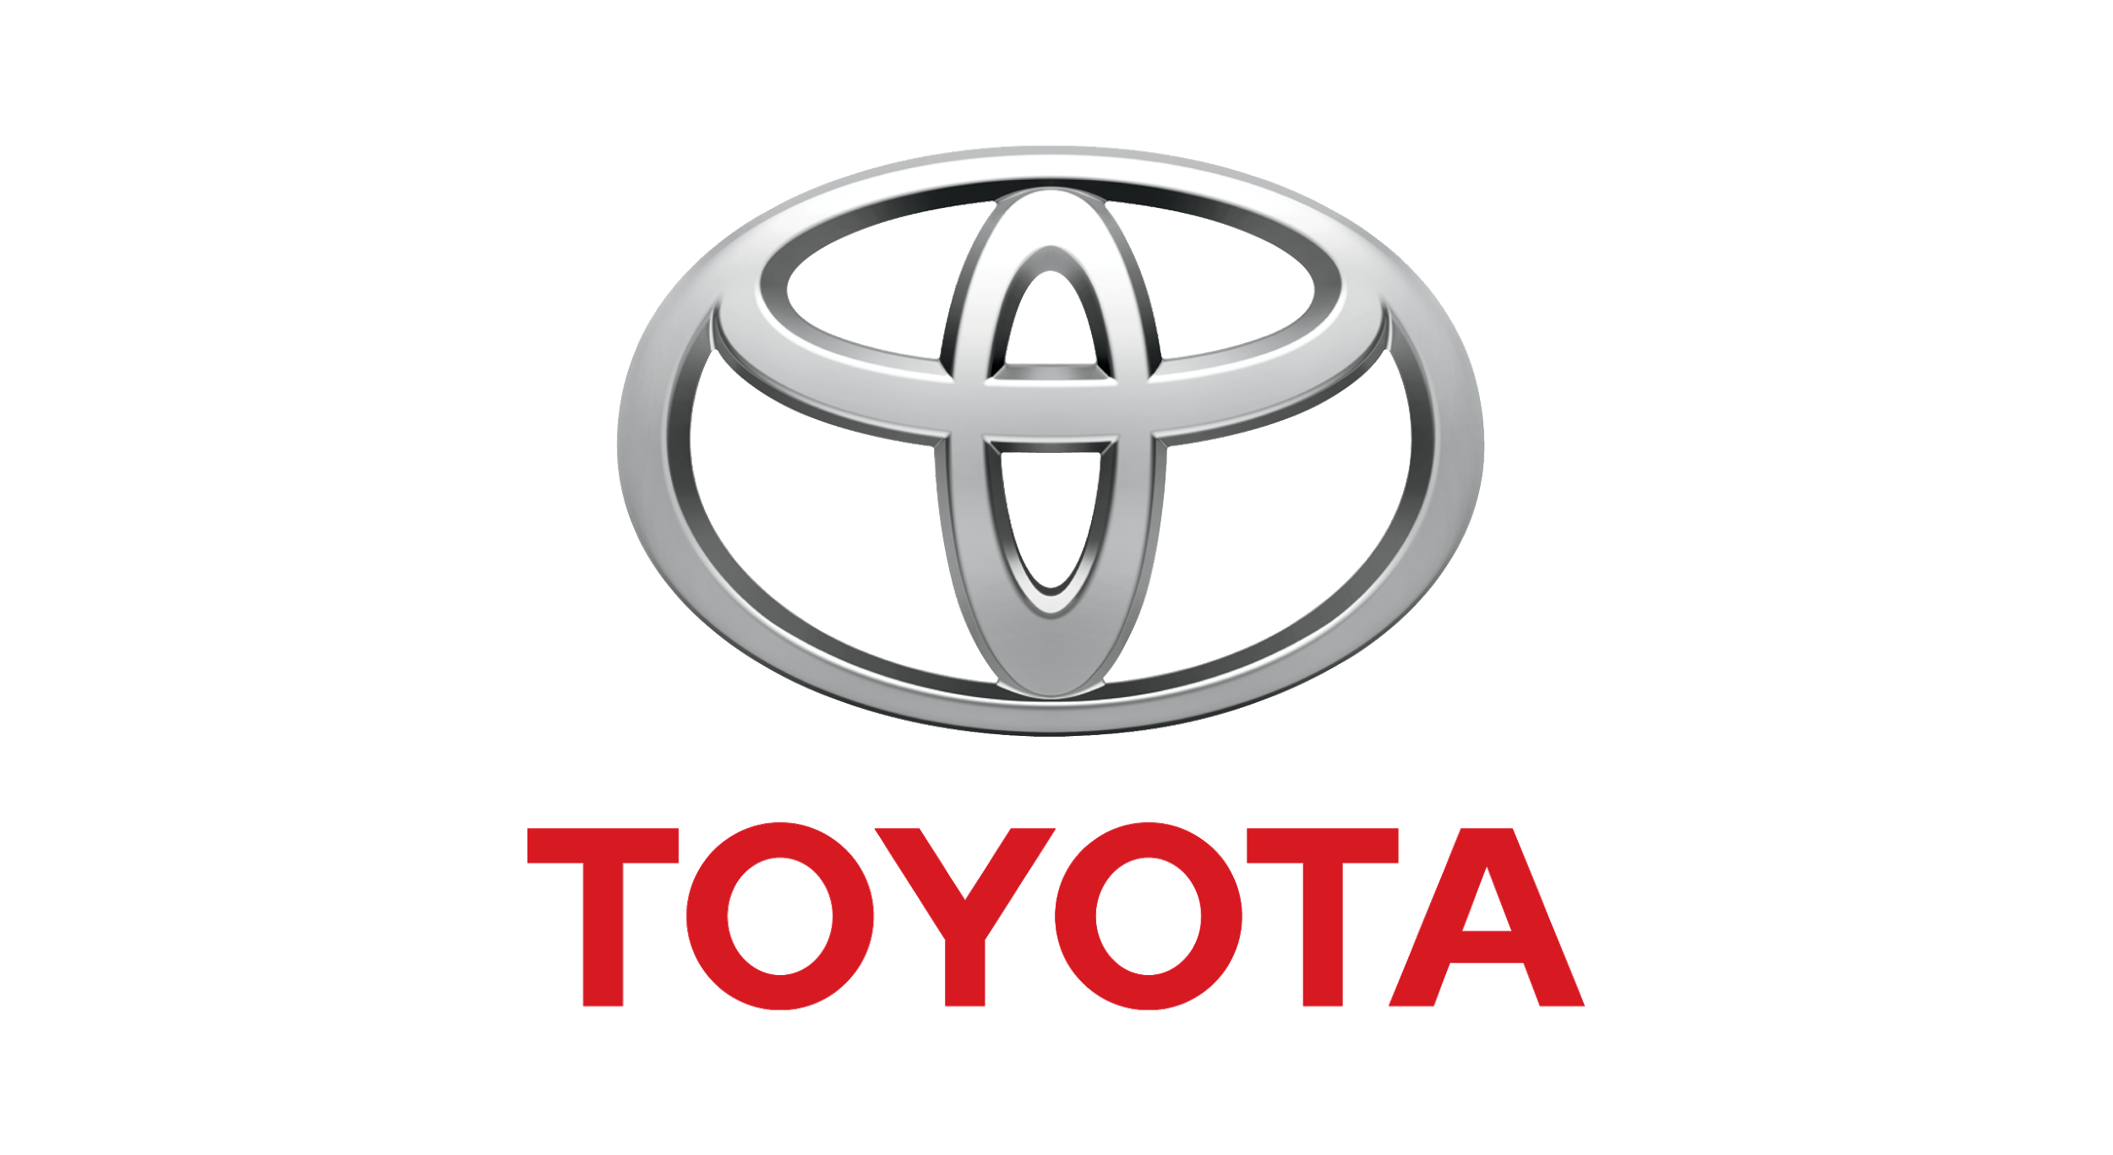



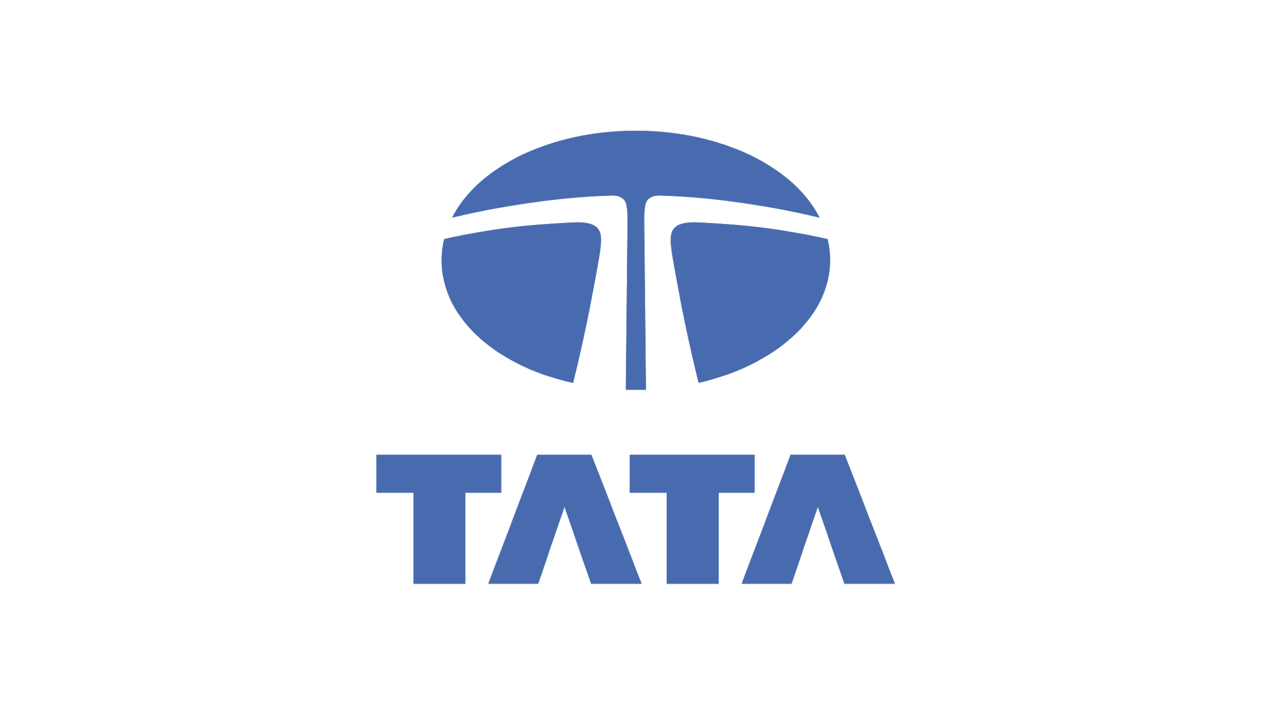

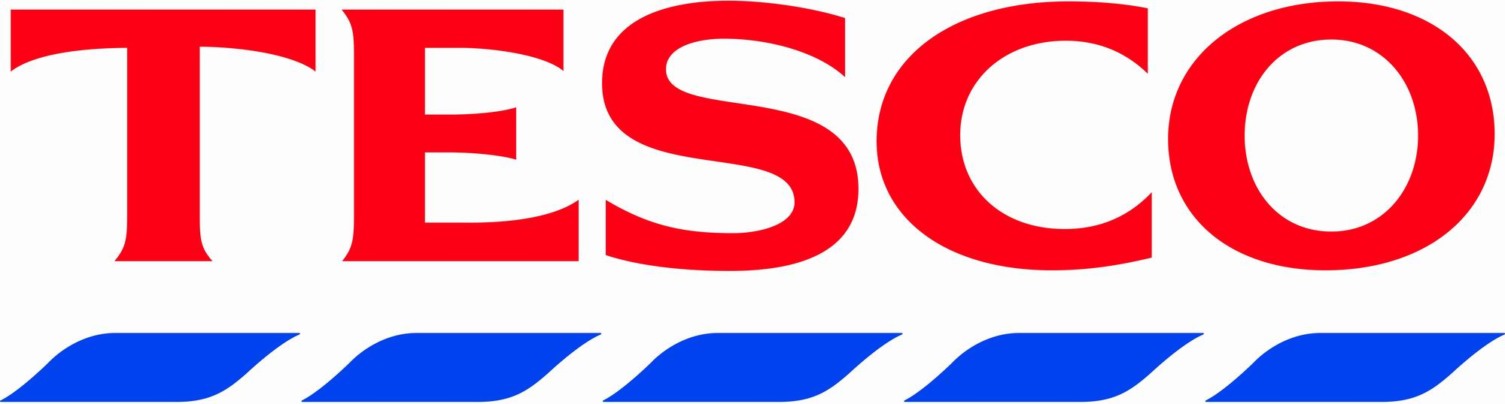




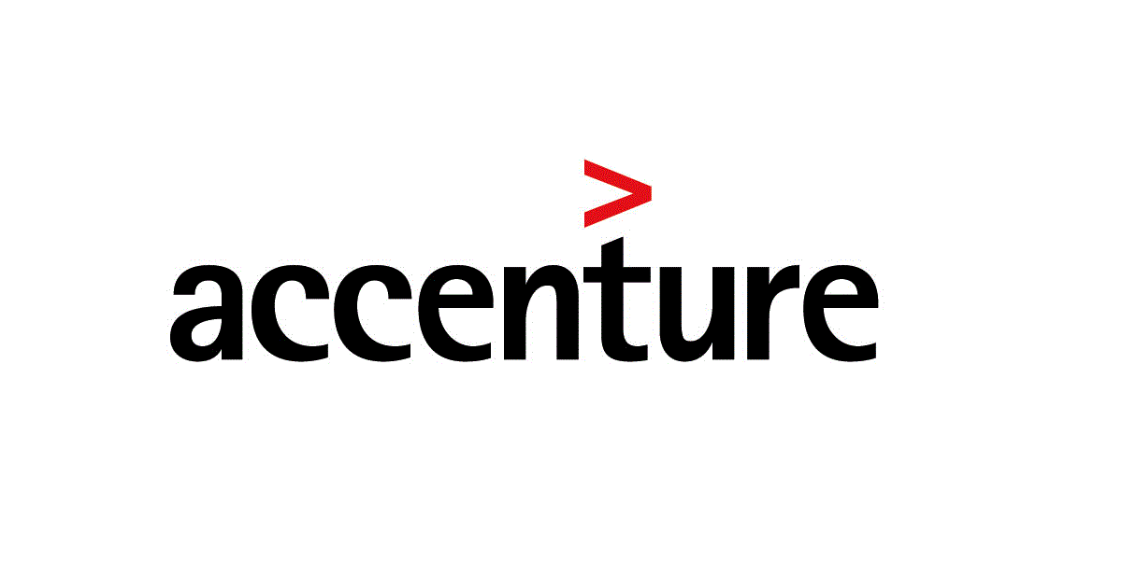
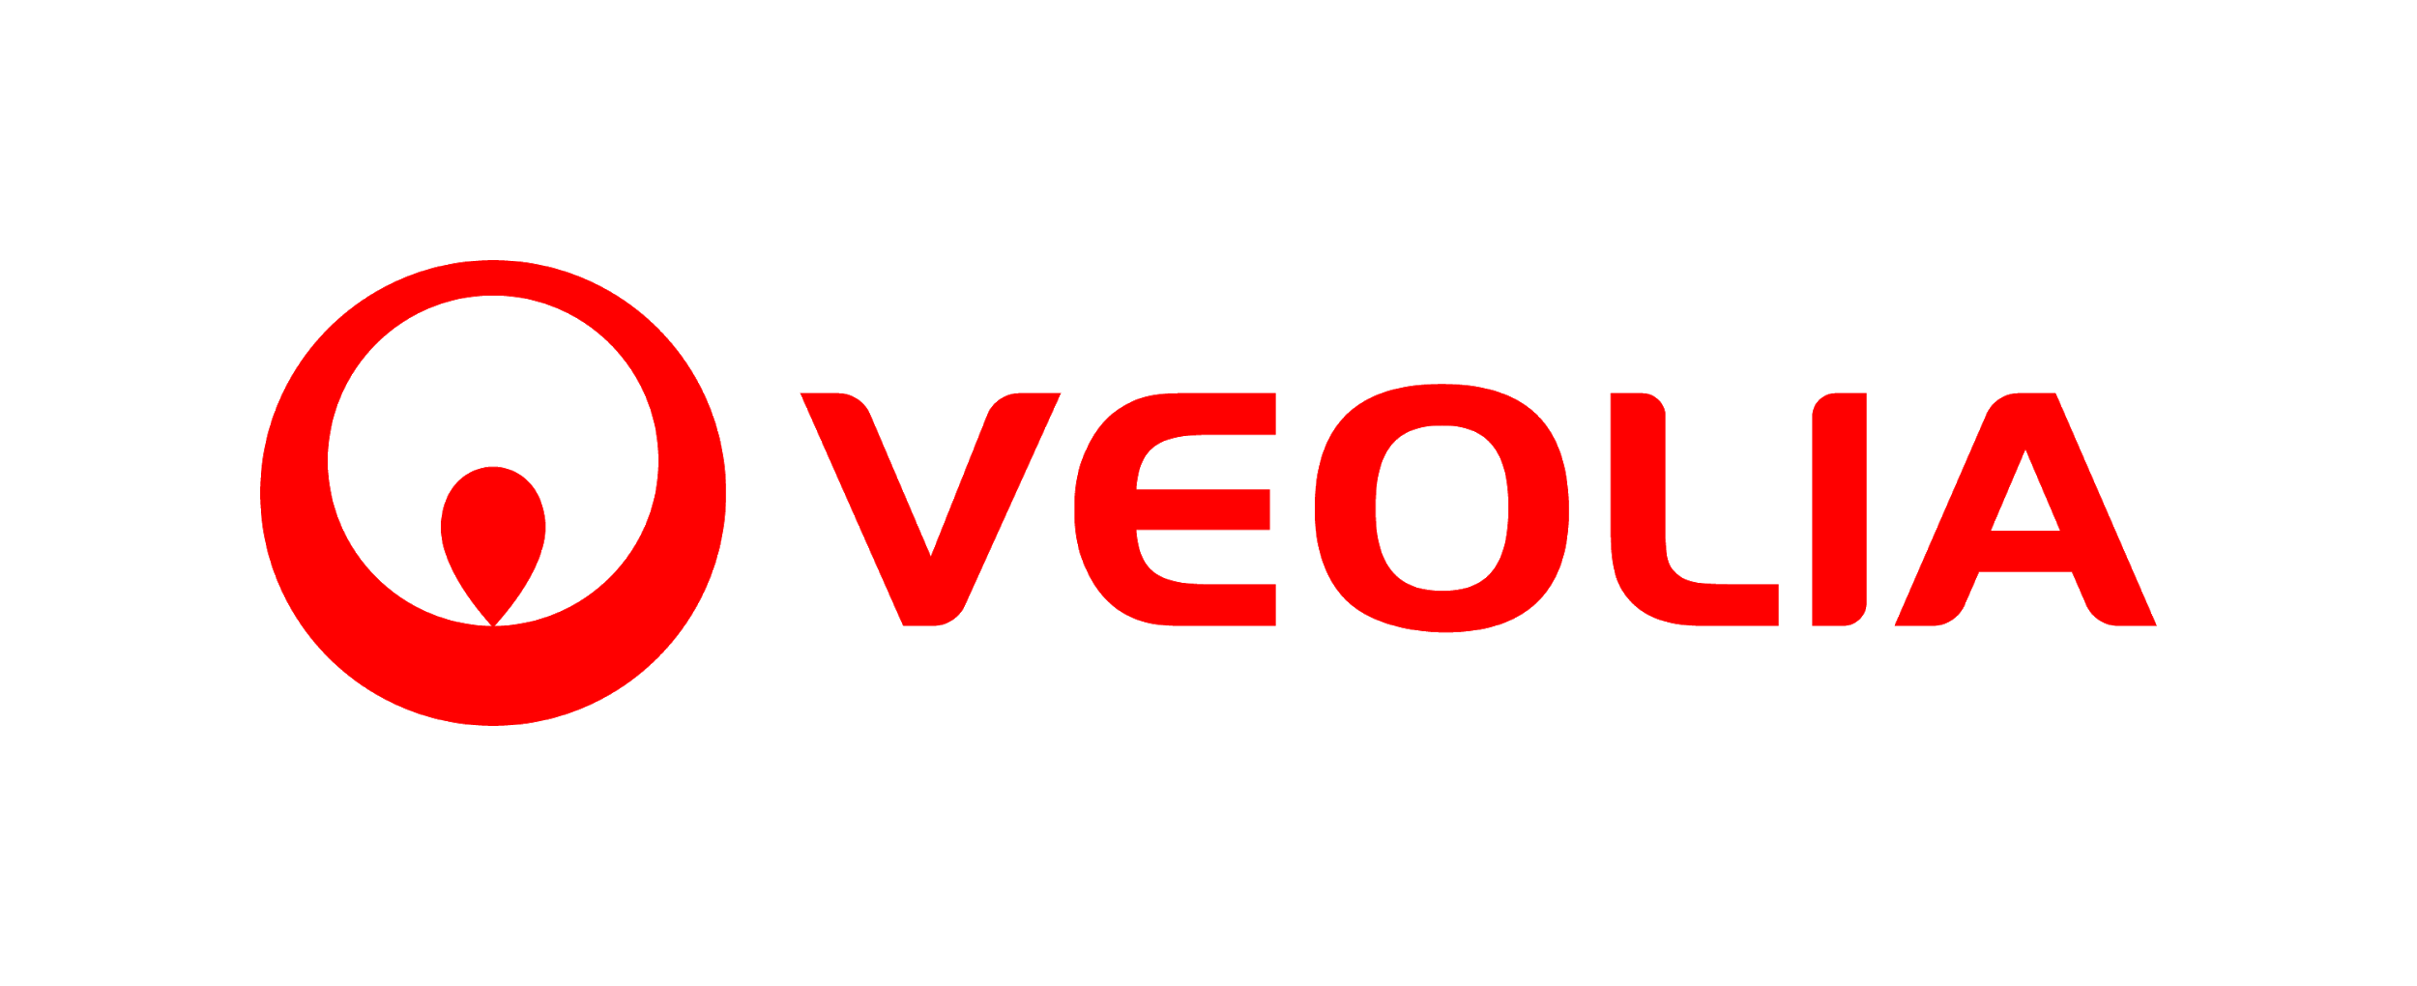
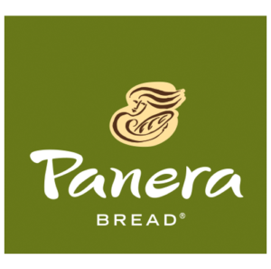

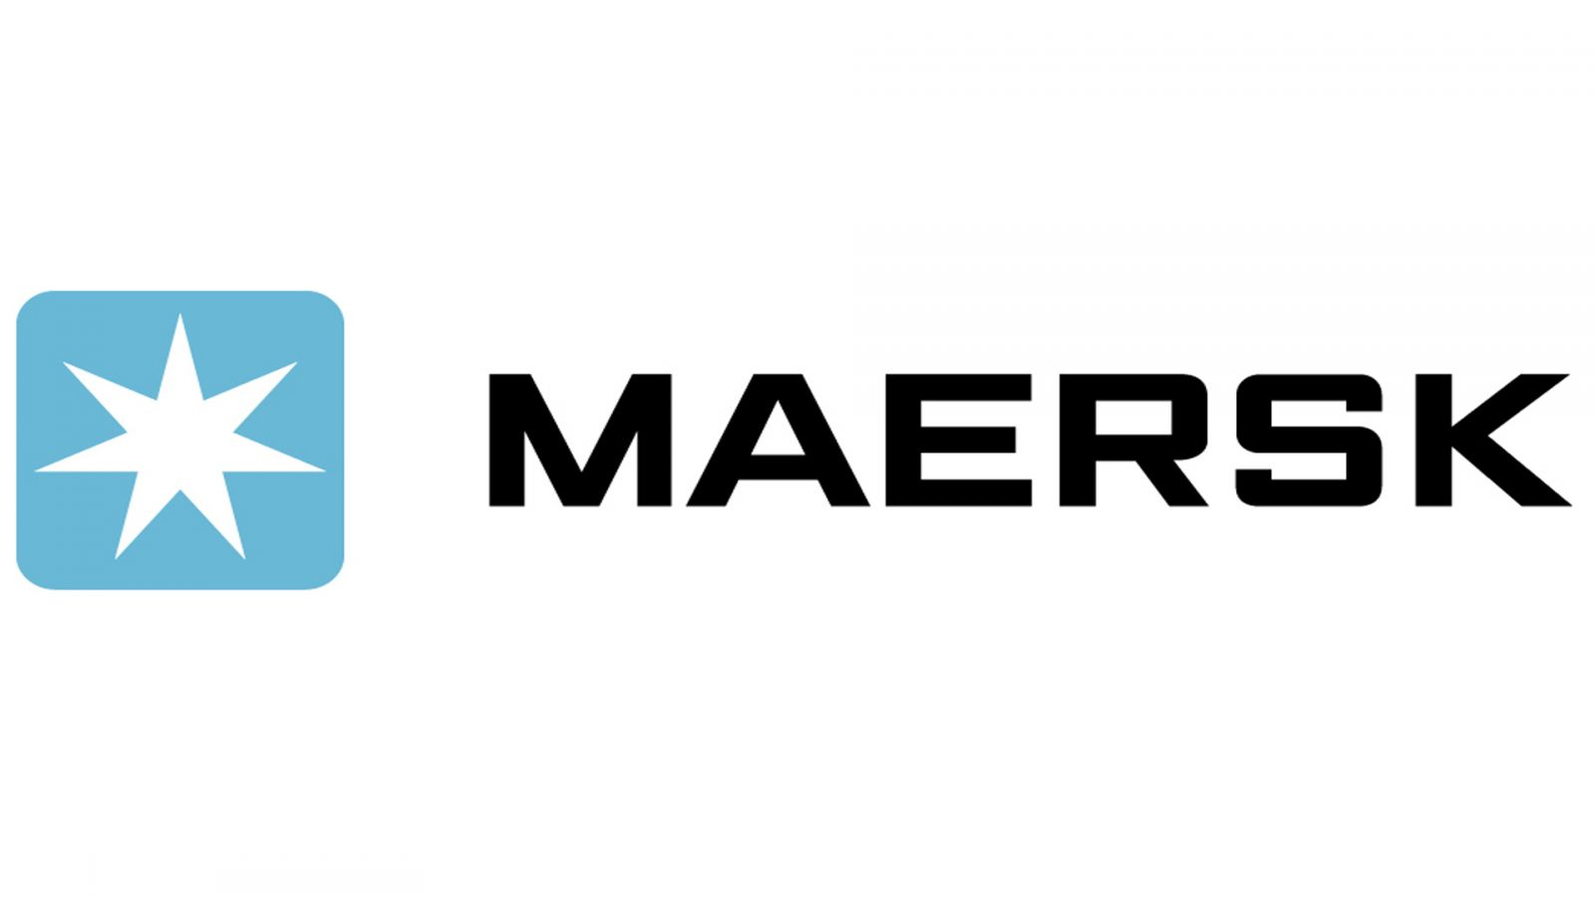
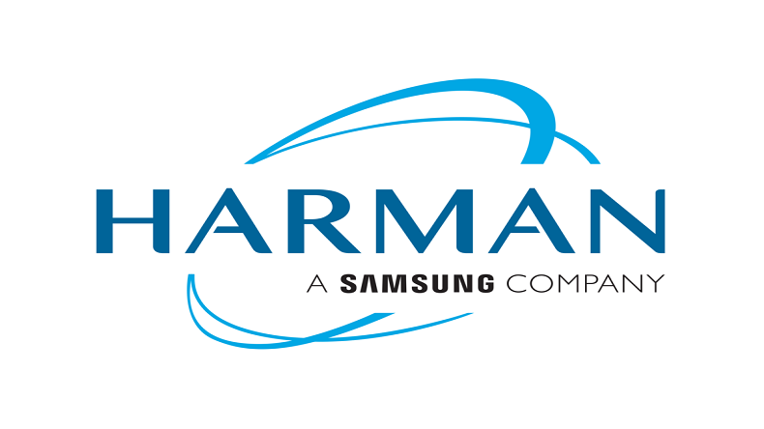
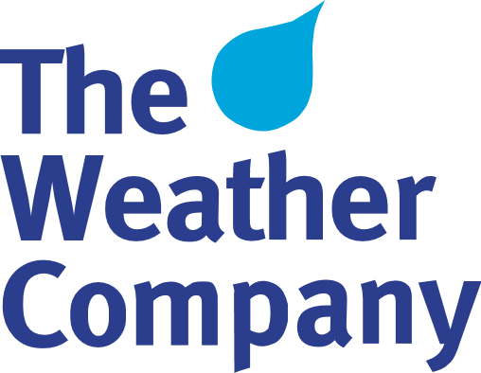
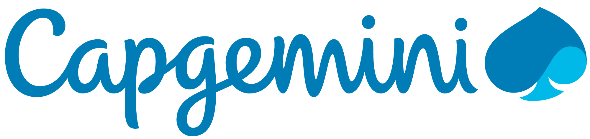
Business clients using these platforms are potential clients

Slide 15
€ 9,374,400
in revenue from
100,000 annual users
With 5 hits/day per user and
20 Business Partners (BP)
With 3 ads/month per BP - 20000 users/ad - € 0.026 for ad

Slide 16
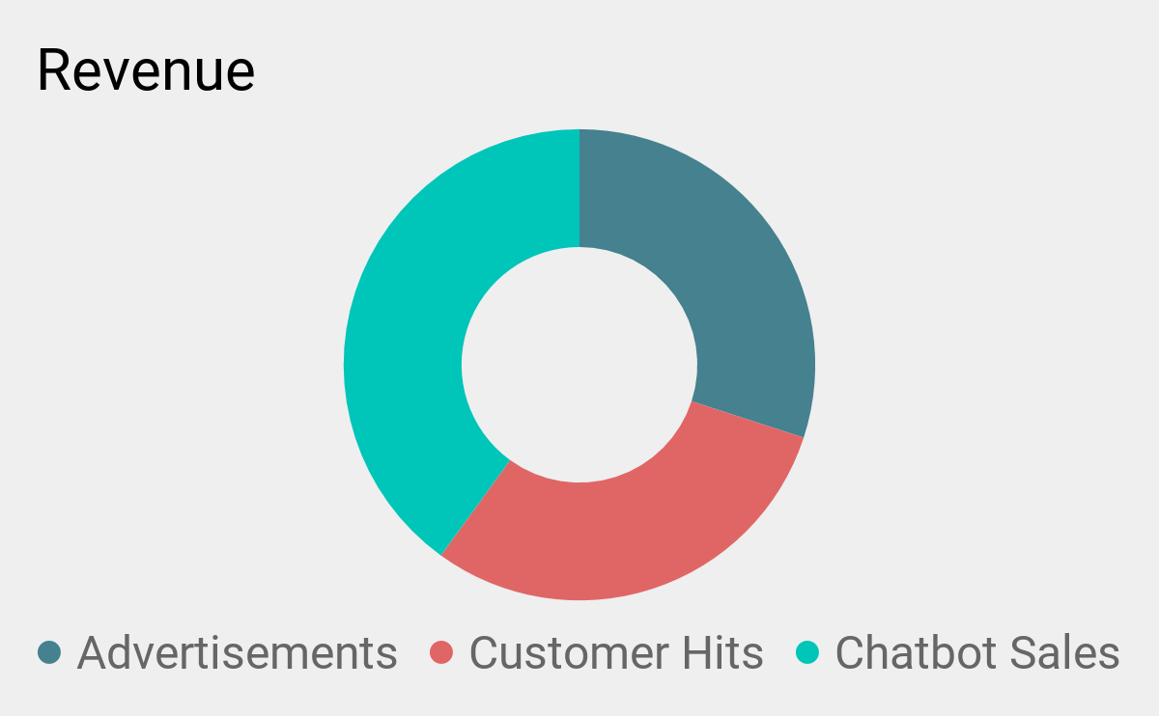
Revenue Streams

Slide 17
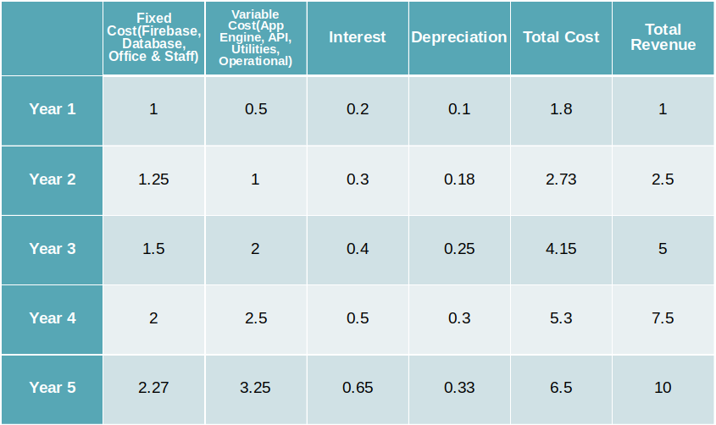
Revenue and Cost Estimates over 5 Years
All figures in Millions

Slide 18
Roadmap
2018 | Early 2019 | Mid 2019
Prototype | Business clients | Release
Co-innovation with Atos Architecture consolidation Build the iOS App Finer UX/UI Prototype finalization | Architecture consolidation Fine-tuned product POC with clients Formulate business strategy (SWOT) Big data analysis | Product launch Promote Delta Fix bugs/updates Sit back and relax!

Slide 19
The SWOT analysis for DELTA!
Strength
Weakness
Potential technologic partners (Atos) working on this topic
Tier One mobilized
Complex project to drive
Requires resources to get a matured product
External Internal
Opportunity
Threat
No competition
Huge business perspective
Coming trend
Already some R&D initiatives

Slide 20
What Delta offers?
Strong business case
Any type of chatbot can be integrated (Commercial, customer service, etc.).
Estimated earnings: €9.4M
Greater reach
Not restricted to a specific user group.
“Delta is available on android which powers 85% of devices”
Robust architecture
App engine capable of handling heavy traffic and guarantee uninterrupted user experience.
“Fully managed and scales as per need ”
Promising growth
With the increasing demand for chatbot services, the market for Delta is HUGE!
“80% of the companies will use chatbots by 2020”

Slide 21
Delta - One bot for all
The revolutionary chatbot application
Coming soon...

